Slide 1
Data Science Rookies Group Project 1
Sunroof Project Analysis
Team #4
Bradley Reardon, Pranay Bhakthula, Baldur Hua, Jichong Wu, Qinyuan Xing

Slide 2
Jichong Notes to all [delete this page after clean up]
At this point and for my work to be helpful to the team, I thought more is better. So I added slides/sections as many as I can, for you guys to do minus work =)
Pls feel free to drop/change anything
Chart numbering in yellow highlight, can be removed later, including for now so it’s clear for you to track my thoughts
Brad: my edits are in red where I changed your line – feel free to edit again

Slide 3
Delete this(Baldur)
I added few things based on the latest ‘patch’ by Jichong.
Make sure we review the whole thing before submitting.
There may be some inconsistence.

Slide 4
Outline
Data Set Overview
Exploratory Data Analysis
Model Building
Conclusions
Prediction (If time allows)

Slide 5
Data Set Overview

Slide 6
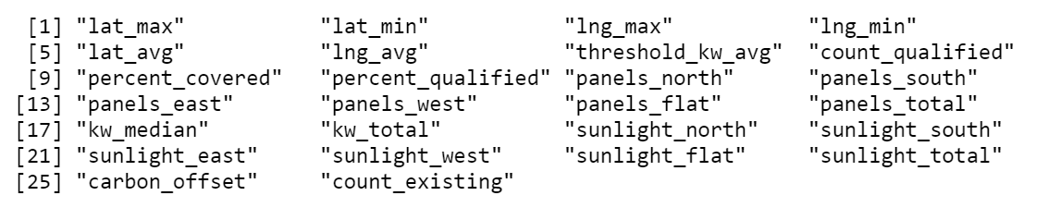
Data Set Overview
The dataset, compiled by the Google Sunroof Project, contains the number of solar panels, along with the amount of solar energy generated and carbon dioxide abatement in different cities of United States.
Dataset Source: Kaggle
7,899 observations and 26 variables (After rearrangement)

Slide 7
S.M.A.R.T Questions
Analyze the effects of estimated annual sunlight and number of potential panel types on the total solar energy generation potential per US city and region.
Determine the estimated potential carbon offset from solar energy use per region.

Slide 8
Exploratory Data Analysis

Slide 9
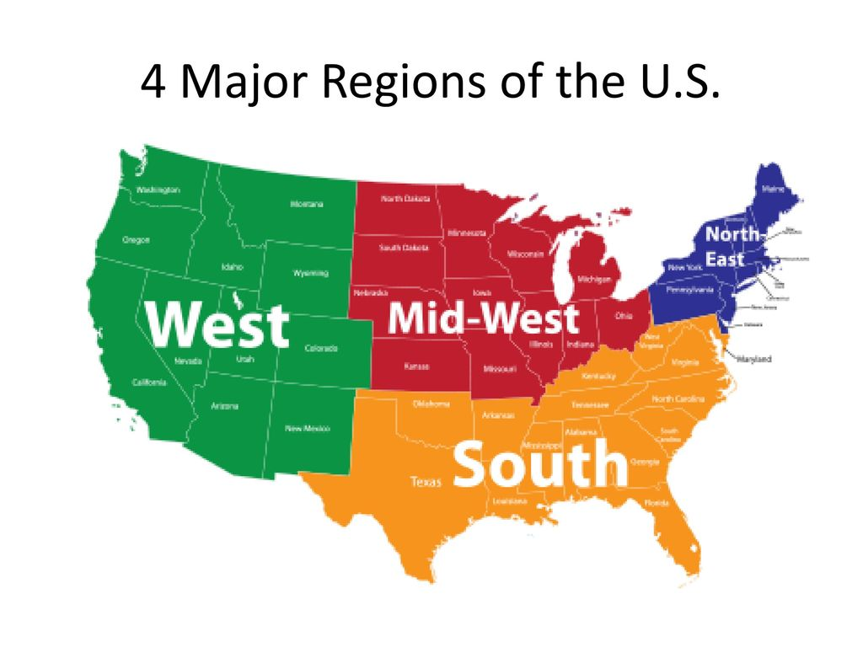
To Prepare for EDA:
Dropped 3 variables: median number of panels, median yearly sunlight (used mean values instead), install size (irrelevant to our analysis)
Shortened/renamed column titles for readability
Changed data types for numerical columns from string to numeric.
Excluded the NA values.
Created the region column as factor data for comparison analysis
Four levels: Northeast, South, Midwest, West

Slide 10
Exploratory Data Analysis
Data aggregates overview
Count total # of cities by region (chart1)
Count total # of solar panels with direction breakdowns by region (chart2)
Count total solar energy production potential by region (chart3)
Get additional independent variables
Calculate the average solar energy potential generated by each panel by region (charts 4-8, table1)
Find sunlight energy potential per panel per direction for each city
i.e. sunlight_north / panels_north = estimated total solar energy generation potential per panel in city x
Relationship check for model building (below 4 + above 2)
Any relationship between carbon offset and solar panels? (qq-plot + cor test)
Any relationship between carbon offset and solar potential? (qq-plot + cor test)
Any relationship between carbon offset and solar panel direction? (qq-plot + cor test)
Any relationship between carbon offset and solar location (use lat, long data)? (qq-plot + cor test)

Slide 11
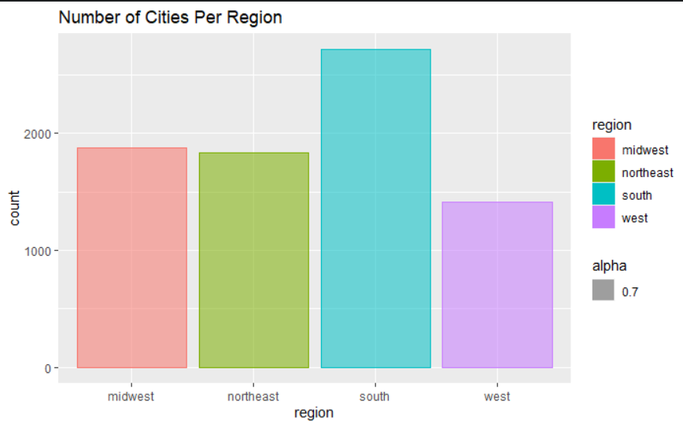
Total # of Cities by Region – Chart1 Chart 2 missing (don’t have to)

Slide 12
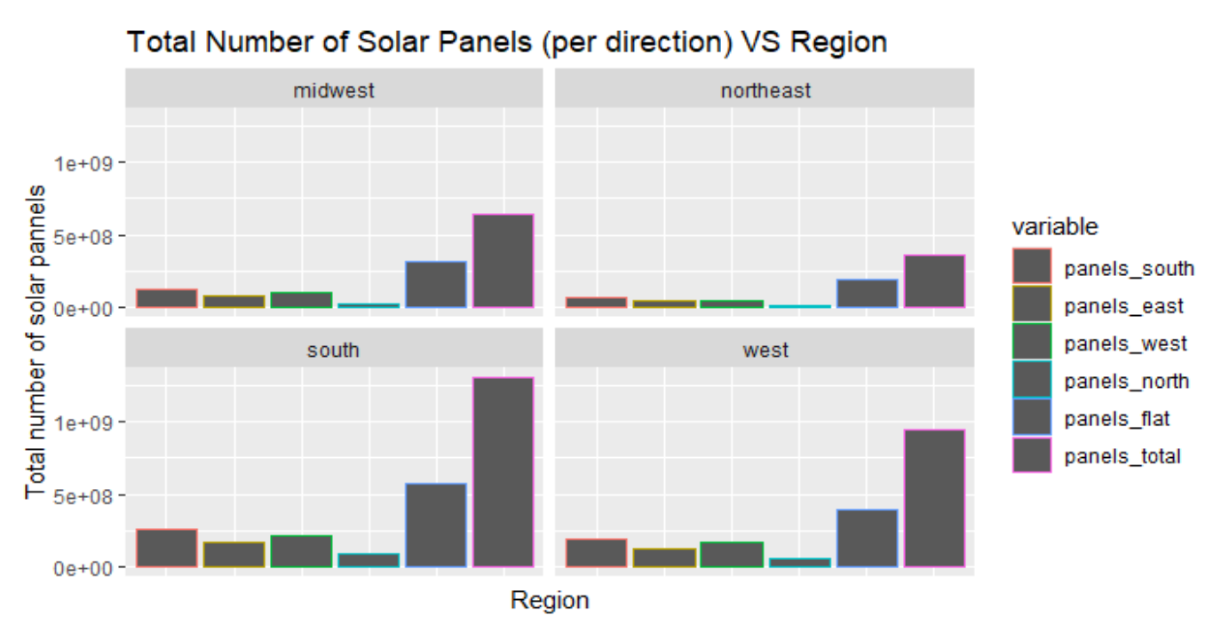
Chart 2 Total number of solar panels with direction breakdowns by region

Slide 13
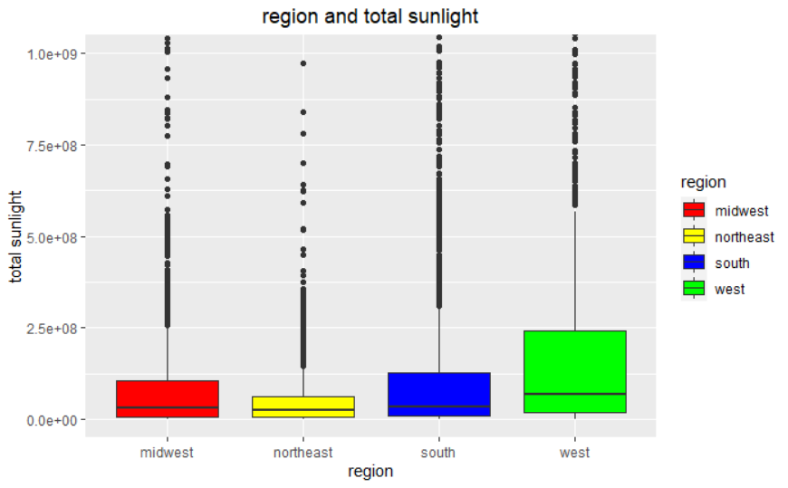
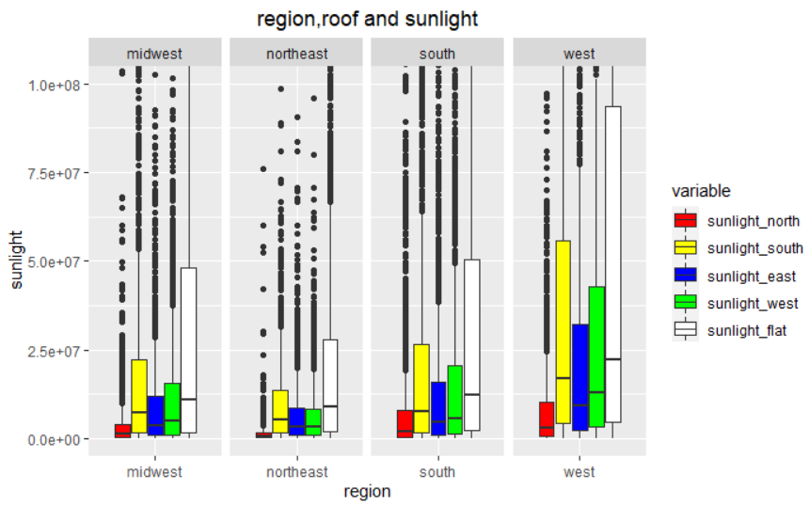
Total solar energy production potential by region – chart3 (Both of these two needed)

Slide 14
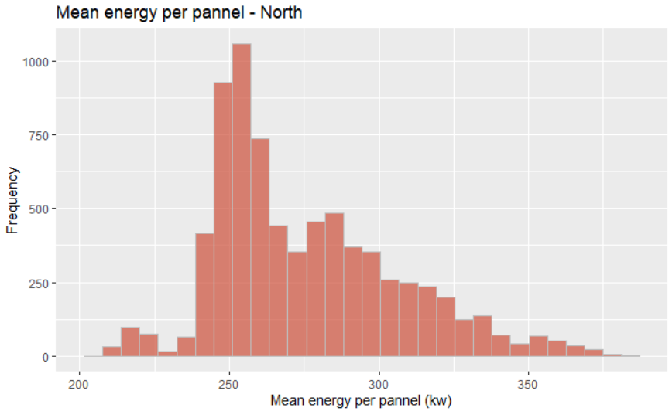
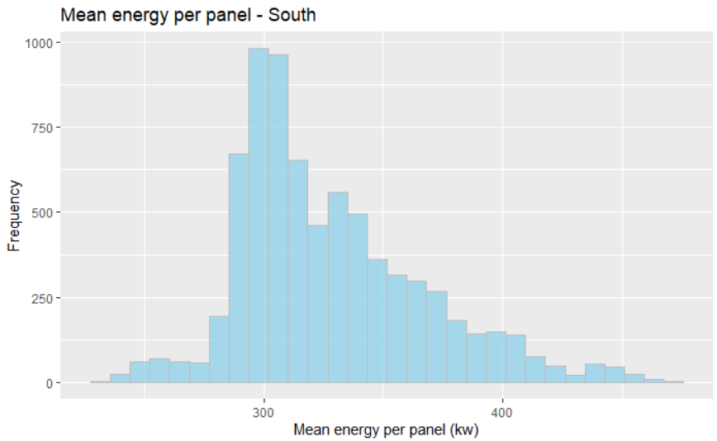
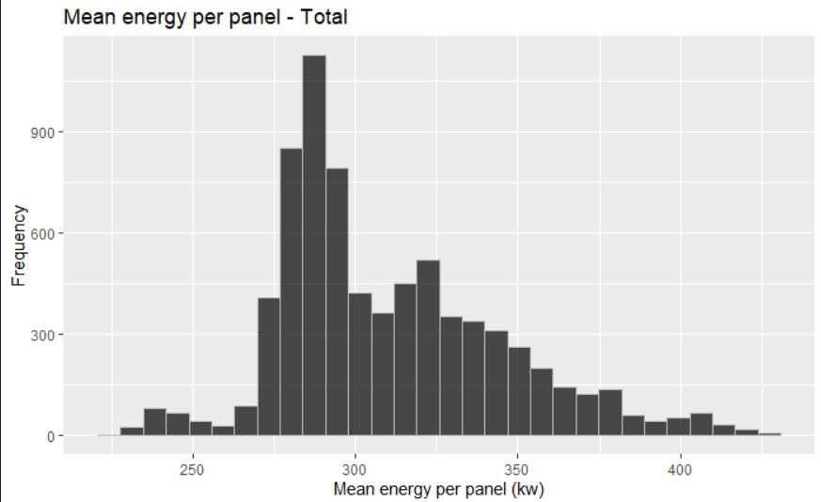
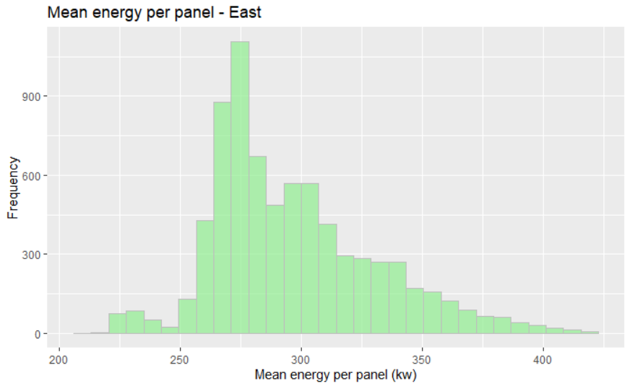
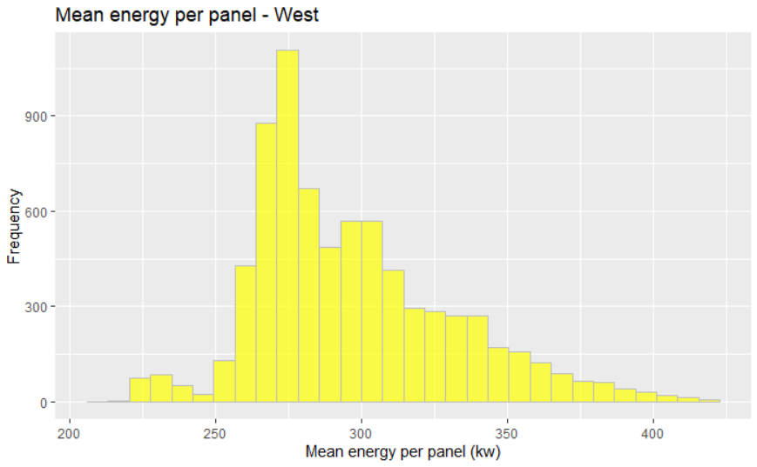
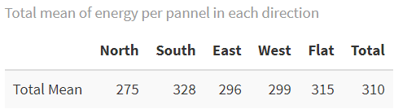
Average solar energy potential generated per panel by region – Chart 4-8

Slide 15
Relationship check for model building (below 4 + above 2) Any relationship between carbon offset and solar panels? (qq-plot + cor test) Any relationship between carbon offset and solar potential? (qq-plot + cor test) Any relationship between carbon offset and solar panel direction? (qq-plot + cor test) Any relationship between carbon offset and solar location (use lat, long data)? (qq-plot + cor test) Need these charts, only if team agrees

Slide 16
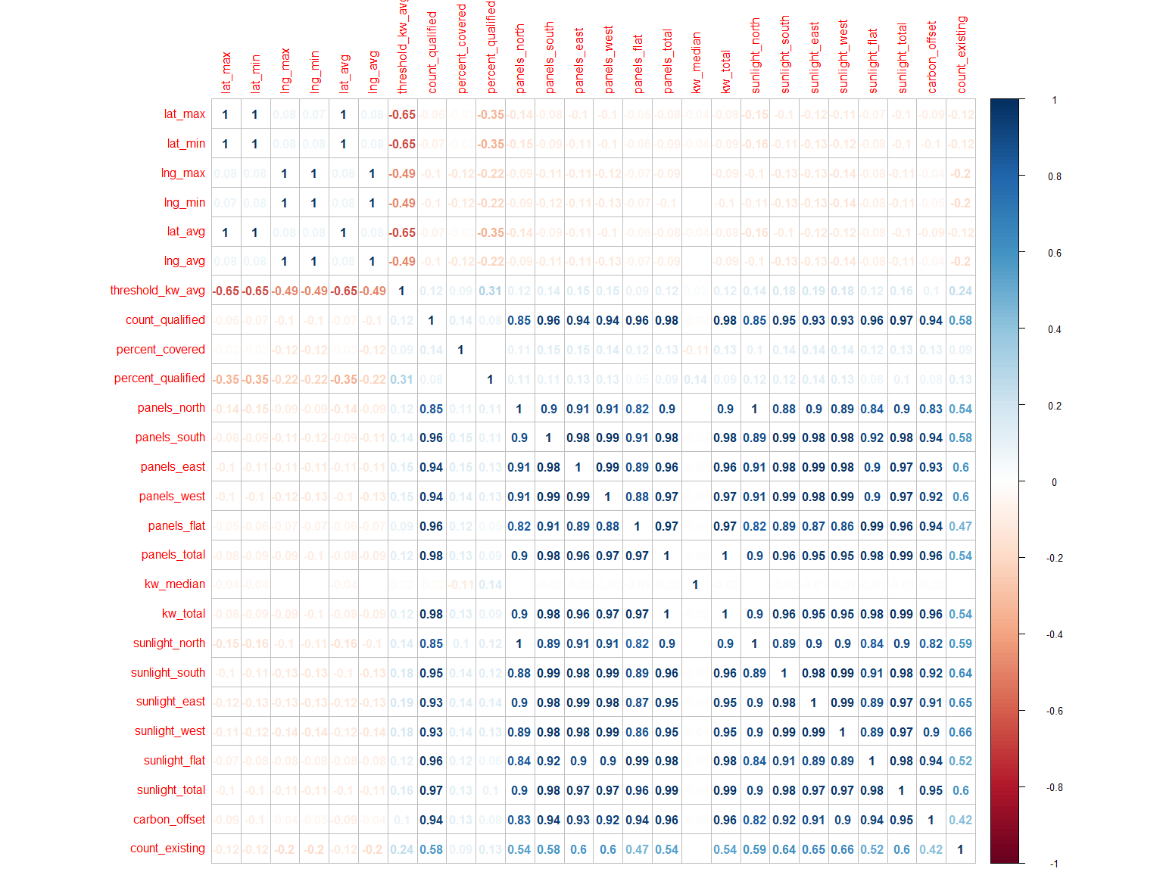
Correlation checking

Slide 17
Model Building

Slide 18
ANOVA: do the mean values of solar energy potential generated by each panel differ by region?
From previous slides: calculate the average solar energy potential generated by each panel by region (charts 4-8, table1)
A snapshot picture – ANOVA result summary

Slide 19
ANOVA: do the sunlight energy potential per panel per direction diff by region?
Find sunlight energy potential per panel per direction for each city
i.e. sunlight_north / panels_north = estimated total solar energy generation potential per panel in city x
A snapshot picture – ANOVA result summary

Slide 20
Lm(carbon offset ~ total solar energy potential)
A snapshot of a model summary results

Slide 21
Lm(carbon offset ~ total solar energy potential + # of solar panels)
A snapshot of a model summary results

Slide 22
Lm(carbon offset ~ total solar energy potential + # of solar panels + location (we can code 4 region by 4 categorical levels))
A snapshot of a model summary results

Slide 23
Lm(carbon offset ~ total solar energy potential + # of solar panels + location (we can code 4 region by 4 categorical levels) + panel direction (we can code directions into 4 categorical levels – NSEW?)
A snapshot of a model summary results

Slide 24
VIF test on all the variables

Slide 25
Conclusion

